Slide 1
DL: Constance
김종민 jmkim@pukyong.ac.kr
2019/09/25

Slide 2
Content
3-Layer architectures
Ingestion
Maintenance
(Metadata tagging)
Explicit schema definitions
Semi-structured data
Structural Metadata Discovery
(Metadata linking)
Semantic annotations
Semantic Metadata Matching
Schema Grouping
Schema Summary
Query Answering
Query Rewriting Engine
Query Formulation

Slide 3
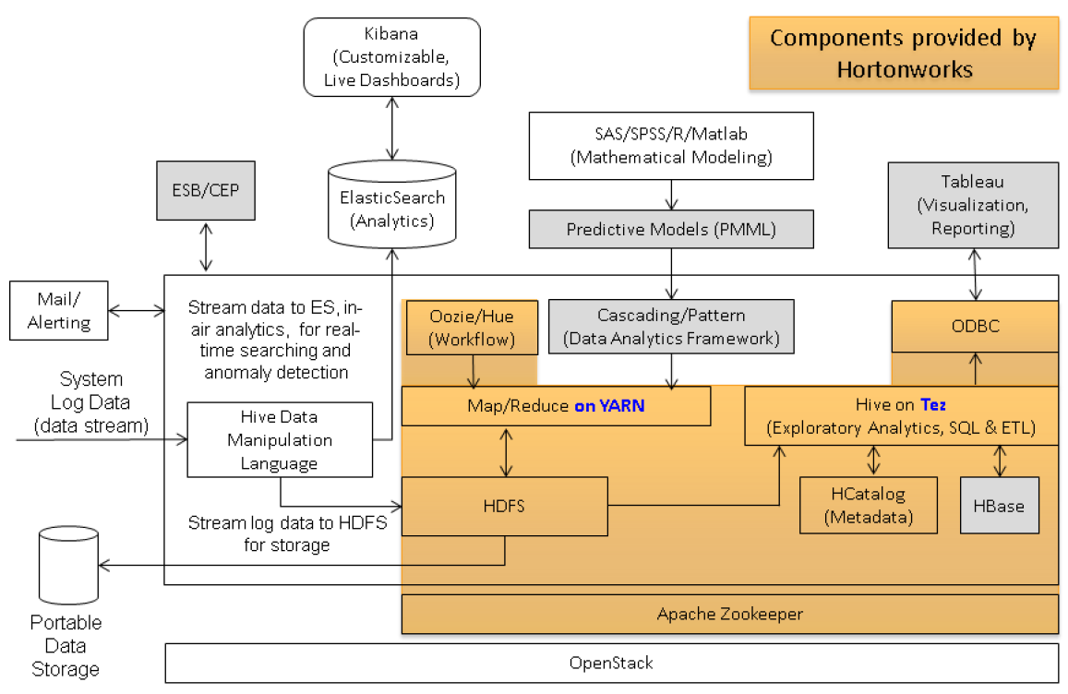
Traditional Hadoop-based Data Lake
ADS-B Data Lake Architecture
Notes:
ADS-B DL Arch: https://ieeexplore.ieee.org/document/7121281

Slide 4
Traditional Hadoop-based Data Lake
Lack details about the required modules
Metadata management features
Methods for efficient query processing
Hampers repeatable implementations
Application-specific solutions
Based on generic software framework (not for DL) such as Hadoop
Require a lot of forces for adaptation/customization for creating the DL

Slide 5
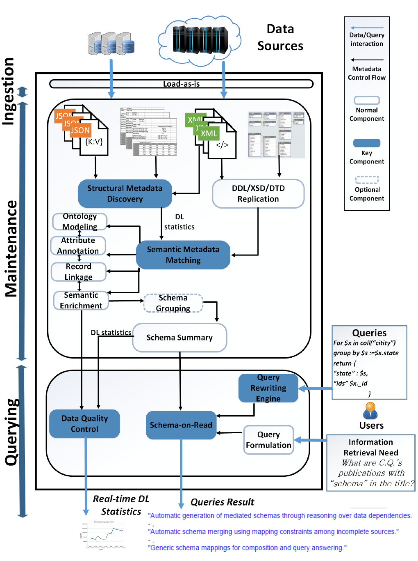
Constance architecture
3-Layer architectures
Ingestion
Importing data from heterogeneous sources
Maintenance
Basic functions for data storage and efficient querying
Query Answering
Serve for information retrieval

Slide 6
Ingestion
Responsible for importing data from heterogeneous sources
Loads data in its original format
w/o forcing expensive transformation
w/o any integration tasks
Normally, Data Ingestion layer does
Versioning
Versioning feature is never mentioned in Constance.
Indexing
In Constance, indexing is done by Maintenance layer.
Notes:
Data Ingestion: https://www.semanticscholar.org/paper/Data-Lake-Management%3A-Challenges-and-Opportunities-Nargesian-Zhu/a160a1eb5636a12461ba7b3518bac161f3378bd4

Slide 7
Maintenance
Metadata management functions
Metadata is crucial for future querying
w/o metadata, DL quickly into a “data swamp”
Extracting as much metadata as possible from the sources
Semantic Metadata Matching
(Semantic Annotation)
Structural Metadata Discovery
Ontology Modeling
Semantic Enrichment
Schema Replication
Attribute Annotation
Schema Grouping
Schema Summary
Record Linkage

Slide 8
Structural Metadata Discovery
Files containing the explicit schema definitions
E.g. SQL (DDL), XSD, DTD
Do the replication for the schema definitions
Semi-structured data
E.g. XML w/o XSD, JSON, CSV, Excel files
Do the Structural Metadata Discovery

Slide 9
Structural Metadata Discovery
First, check whether metadata is
Encoded inside the raw data file
In the file name
The directories of the file system
Second,
discover the “Has-a”-relationships
Store them(^) in a “path-like” structure

Slide 10
Path-like: XPath for XML
<?xml version="1.0" encoding="UTF-8"?>
<bookstore>
<book category="cooking">
<title lang="en">Everyday Italian</title>
<author>Giada De Laurentiis</author>
<year>2005</year>
<price>30.00</price>
</book>
<book category="children">
<title lang="en">Harry Potter</title>
<author>J K. Rowling</author>
<year>2005</year>
<price>29.99</price>
</book>
<book category="web">
<title lang="en">XQuery Kick Start</title>
<author>James McGovern</author>
<author>Per Bothner</author>
<author>Kurt Cagle</author>
<author>James Linn</author>
<author>Vaidyanathan Nagarajan</author>
<year>2003</year>
<price>49.99</price>
</book>
<book category="web">
<title lang="en">Learning XML</title>
<author>Erik T. Ray</author>
<year>2003</year>
<price>39.95</price>
</book>
</bookstore>
XPath Expression | Result
/bookstore/book[1] | Selects the first book element that is the child of the bookstore element
/bookstore/book[last()] | Selects the last book element that is the child of the bookstore element
/bookstore/book[last()-1] | Selects the last but one book element that is the child of the bookstore element
/bookstore/book[position()<3] | Selects the first two book elements that are children of the bookstore element
//title[@lang] | Selects all the title elements that have an attribute named lang
//title[@lang='en'] | Selects all the title elements that have a "lang" attribute with a value of "en"
/bookstore/book[price>35.00] | Selects all the book elements of the bookstore element that have a price element with a value greater than 35.00
/bookstore/book[price>35.00]/title | Selects all the title elements of the book elements of the bookstore element that have a price element with a value greater than 35.00
Notes:
XPath: https://www.w3schools.com/xml/xml_xpath.asp

Slide 11
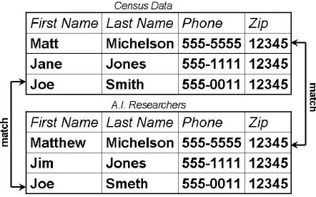
Semantic Metadata Matching
= Semantic Annotation
Ontology modeling
Attribute annotation
Record linkage
Semantic enrichment
Semantic Grouping
Semantic Summary
Standardized domain-specific models or ontologies which provide a common, shared understanding for the domain
Record Linkage
Notes:
Record Linkage: https://www.researchgate.net/publication/221606940_Learning_Blocking_Schemes_for_Record_Linkage
온톨로지: https://joyhong.tistory.com/attachment/cfile3.uf@113F8C4B4FA33EAC119BC6.pdf

Slide 12
Semantic Metadata Matching
(Ontology naming convention)
File Storage
foaf:lastName
File D
Last Name
DoB
foaf:name
Schema Grouping
Semantic
Annotation
File E
Semantic
Annotation
File C
dob
foaf:firstName
Last name
foaf:birthday
Semantic
Annotation
File F
File B
Birthday
Given name
Surname
File G
File A
Birth
First name
Notes:
온톨로지: https://joyhong.tistory.com/attachment/cfile3.uf@113F8C4B4FA33EAC119BC6.pdf

Slide 13
Semantic Enrichment
Schema Grouping
Clusters the schemas
Pick up the core of each cluster as its presentation
Schema Summary
“Skeleton”
Extracts a further compact structure of the currently managed schemata

Slide 14
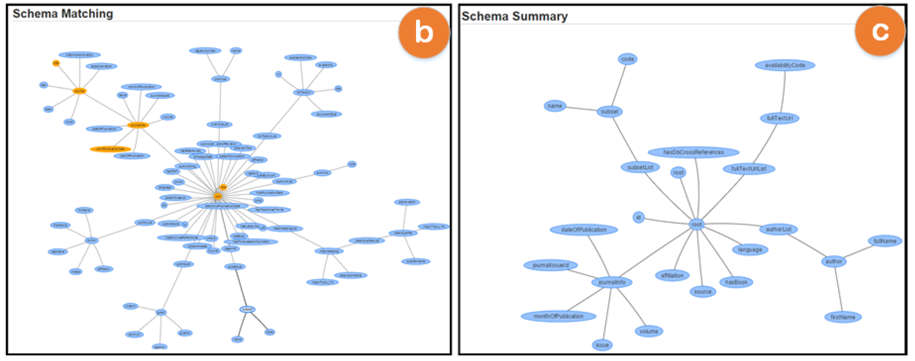
Semantic Enrichment: Schema Summary
foaf:name
foaf:birthday
Birth
Schema Grouping
foaf:firstName
foaf:lastName

Slide 15
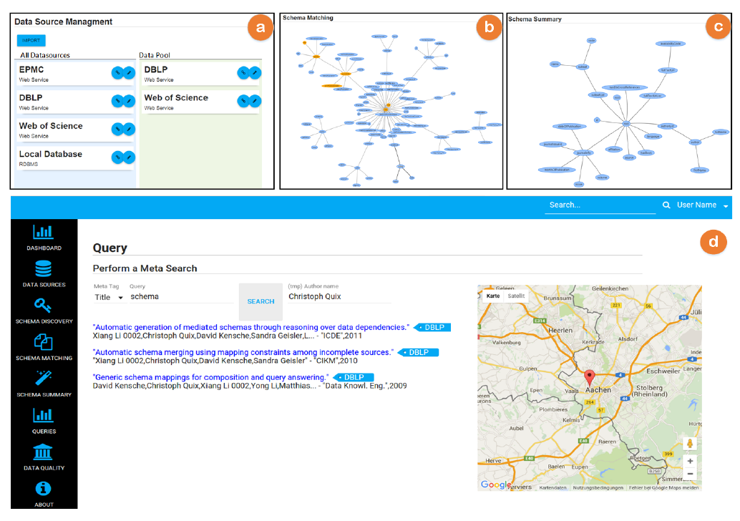
Query Answering
Query-driven discovery
User starts search with a query
Dataset
Keywords
Query answering engine is required
Data-driven discovery
User navigates a DL
Data graph
Hierarchical structure
Data navigation UI is required
Notes:
{Query, Data}-driven discovery: https://www.semanticscholar.org/paper/Data-Lake-Management%3A-Challenges-and-Opportunities-Nargesian-Zhu/a160a1eb5636a12461ba7b3518bac161f3378bd4

Slide 16
Query Answering
Query Language
JSONiq
A query language for JSON-based systems
Like XQuery (which is based-on XPath)
let $stats := collection("stats")
for $access in $stats
group by $url := $access.url
return
{
"url": $url,
"avg": avg($access.response_time),
"hits": count($access)
}

Slide 17
Query Answering
Query Rewriting Engine
Single user query using the semantic terms → (rewrite) → Union of queries using the original schema elements
Query Formulation
Support users in creating formal queries that express the intended information requirements
Keyword → Formal query
Natural language representation → match the related (meta)data items
E.g. “publication” → “author” and “title”

